Slide 1

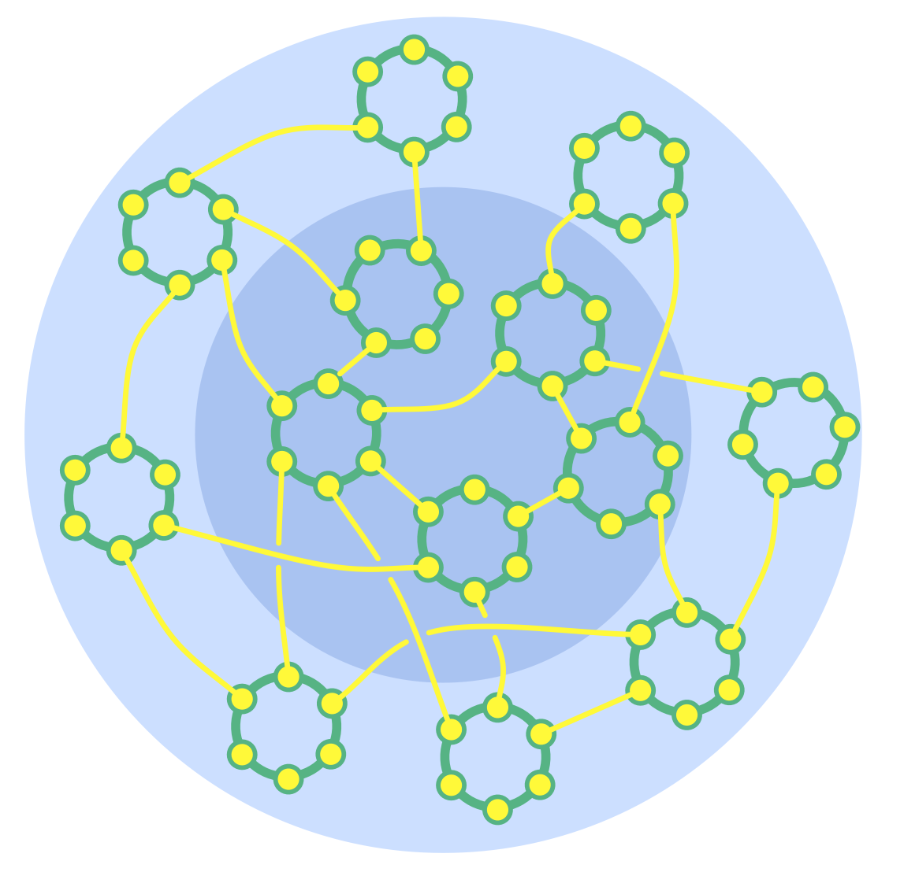
IMPROVING EFFECTIVENESS WITH OPEN ORGANIZATIONAL PRACTICES Barbaros Günay
Notes:
Open Systems
Intentionally communicate with and learn from others outside of your system.
Individuals, groups and entire organizations can acknowledge interdependence and intentionally invite people from outside their system to bring in knowledge, experience and influence to assist with decision making and support collective learning.
Acknowledging its interdependence, an organization can consciously invite outside information, influence or skills to assist with making decisions and to support collective learning.
External experts can offer an outside perspective and bring knowledge, understanding and skills
Representatives of affected parties can inform and influence decision making in ways that benefit overall objectives (see Those Affected Decide)

Slide 2

An Open Framework helps any kind of community to become more
Effective
Agile
Resilient
S3 patterns creates positive open environments for individuals, teams and whole organizations, by enabling people to..:
dynamically steer and evolve their organizations.
learn, transform and grow
make the best use of the skills already present
grow flexible organizational structures in support of effective flow of information.
take an open, iterative approach to adoption
draw on the collective intelligence of the group.
SOCIOCRACY 3.0 (S3)
Notes:
Sociocracy 3.0 (also known as S3) is a framework of patterns for collaboration in organizations that wish to grow more effective, agile and resilient. It be applied in organizations of any size, from small start-ups to large international networks and nationwide, multi-agency collaboration.
It be applied in organizations of any size, from small start-ups to large international
networks and nationwide, multi-agency collaboration.
S3 contains patterns ready to use for many different aspects of collaboration, including
patterns that enable organizations to discover and develop new patterns according to their
needs.
The patterns in S3 form a pattern language, i.e. while each pattern can be applied
independently, patterns mutually reinforce each other, because they are all based on the
same set of principles (see the Seven Principles at the end of the introduction).
S3 patterns facilitate positive transformation for individuals, teams and whole organizations
by enabling people to..:
• ... dynamically steer and evolve their organizations.
• . . . commit to agreements and account for the consequences
• . . . learn, transform and grow
• . . . incrementally process available information into continuous improvement of
products, processes and skills*.
• . . . make the best use of the skills already present
• . . . grow flexible organizational structures in support of effective flow of information.
• . . . take an open, iterative approach to adoption that meets organizations where
they are and enables them to move forward at their own pace.
• . . . draw on the collective intelligence of the group.
• . . . develop creative strategies that are “good enough for now” and “safe enough
to try”.
The focus of this handbook is mostly on S3 in the context of organizations. The patterns
themselves are valuable to any group of people who wish to collaborate effectively, including
communities, municipalities, families, and even one-to-one relationships.

Slide 3
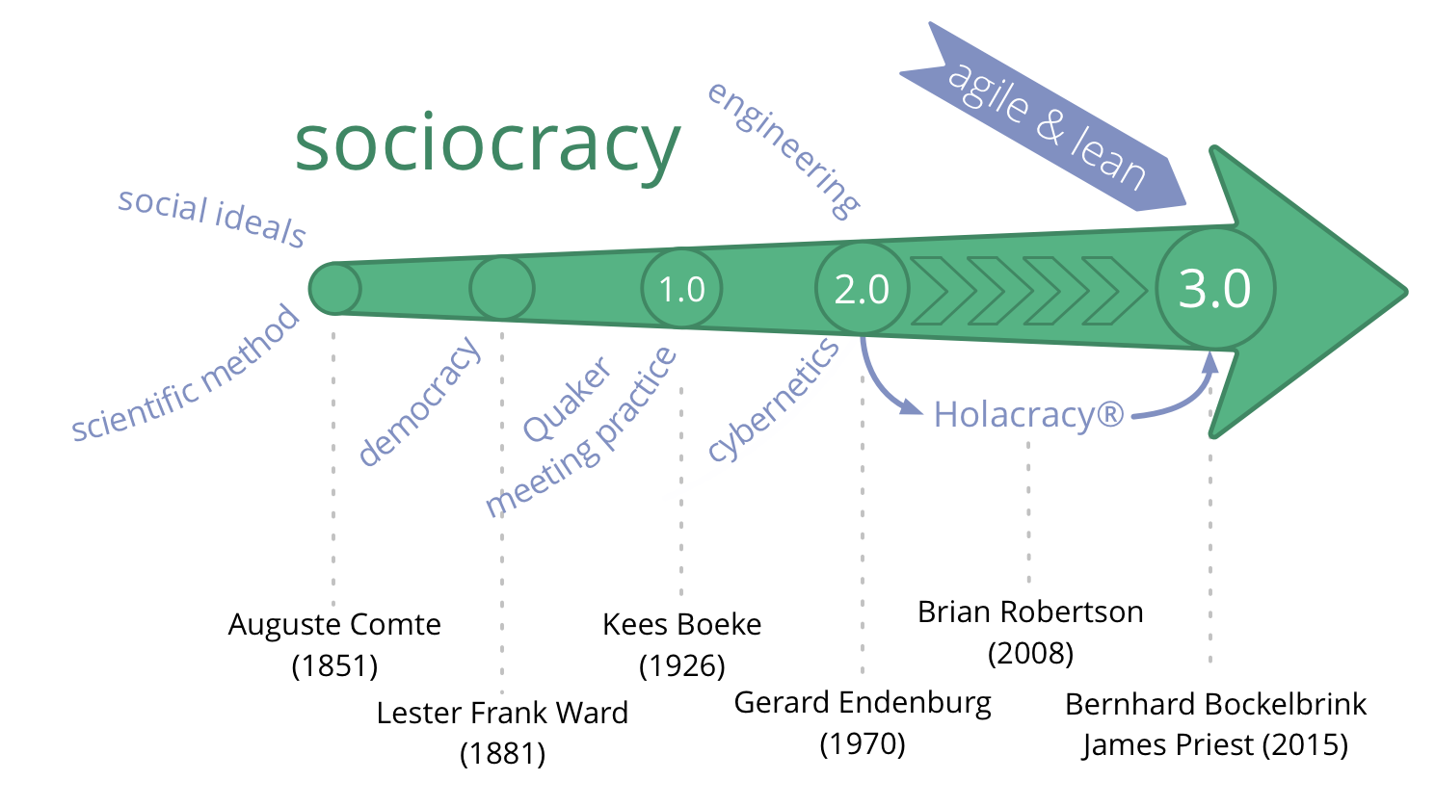

Slide 4
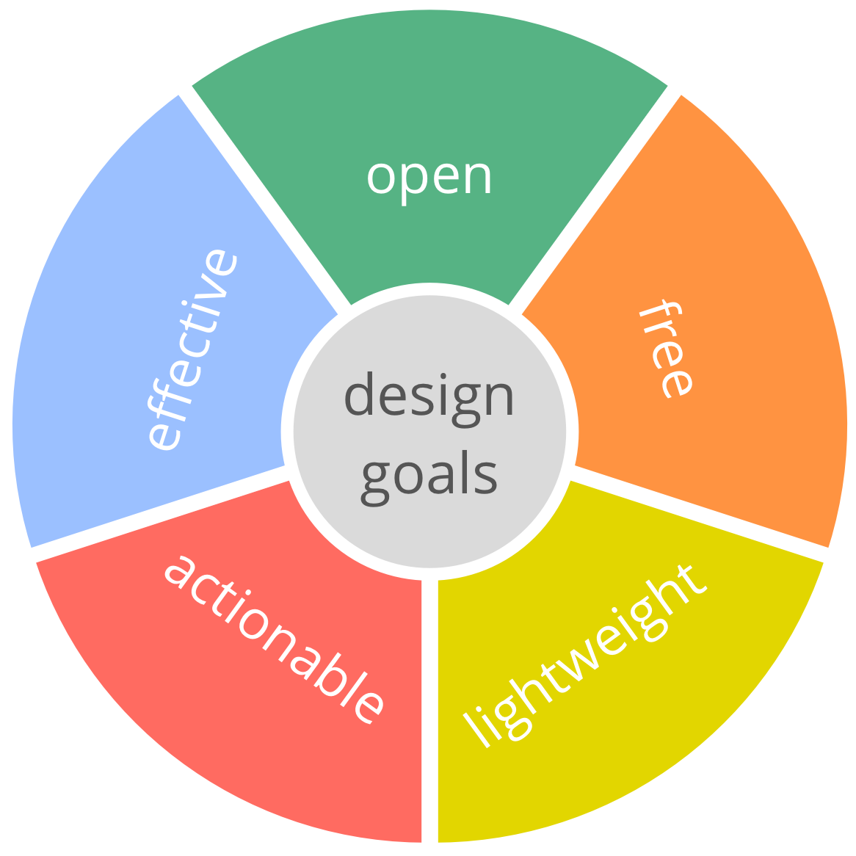
DESIGN GOALS
Notes:
Design Goals Open: Principle-based and modular patterns make it easy to choose and adapt according to context • do with it what you want • take just what you need • remix, extend and adapt it as you like Free: Un-centralized distribution and a Commons license eliminates barriers to entry: • free and accessible resources • no hidden fees • no certifications • no small print Effective: Principles and patterns have been tried and tested in many organizations, often for decades. • need-driven • value-driven customer/user focus Actionable: There’s something any organization can use right now, regardless of their unique context. S3 contains lots of ideas anyone can try out within their area of influence. • patterns for individuals • patterns for groups • patterns for organizations Lightweight: Just the essentials: common-sense practices, bare-bone processes: • free of stuff that gets in the way • no busywork or unnecessary bureaucracy 5.2 The Seven Principles S3 is built on seven core principles, which can also be considered as values that shape organizational culture. Understanding these principles is helpful for adopting and paramount to adapting S3 patterns. Practicing S3 helps people appreciate the essential value of the Seven Principles, both to individuals and organizations The Principle of Effectiveness: Devote time only to what brings you closer towards achieving your objectives. Avoid waste, remove impedimentts and look for solutions which are good enough for now, safe enough to try. The Principle of Consent: Do things only in the absence of reasons why doing so would stand in the way of (more) effectively meeting shared objectives. When dealing with complexity, group wisdom exceeds individual abilities. Deliberately seeking out objections invites collective intelligence to improve an agreement and helps identify misunderstanding early. This fosters support and accountability for agreements made. The Principle of Empiricism: Test all assumptions about an organization and its interactions through experiments, continuous revision and falsification. In any complex adaptive system, such as a group or an organization, all knowledge about the system and its interactions is tentative, and highly dependent on context. Making use of experiences gained from probing and observing the system creates a learning organization which is effective and resilient to change. Empiricism is the basis of the scientific method and the combined application of S3’s patterns provides a direct way to apply the scientific method in an organization. The Principle of Continuous Improvement: Respond to change in small increments, by building on and transforming what is already there, to reduce risk and resistance, and to accommodate steady empirical learning. Most of the time evolution is more effective and more sustainable than revolution. Continuous improvement applies to everything, e.g. strategies, guidelines, products, skills, processes, values and tools. The Principle of Equivalence: People affected by decisions can influence and change them on the basis of reason to do so. Position, rank, function and role have no special influence in decision making. The Principle of Transparency: Make all information accessible to anyone in an organization. Confidentiality requires consent. All relevant information is kept up-to-date, and historical information is archived for reference. The Principle of Accountability: Respond when something is needed and be accountable for doing what you agreed to. The principle of accountability applies to groups, organizations and individuals, and promotes a shift from being held to account, and towards a culture of self-accountability. It implies both making commitments and managing expectations in any relationship: entering agreements, doing what we agree to and to answer for when we don’t.

Slide 5
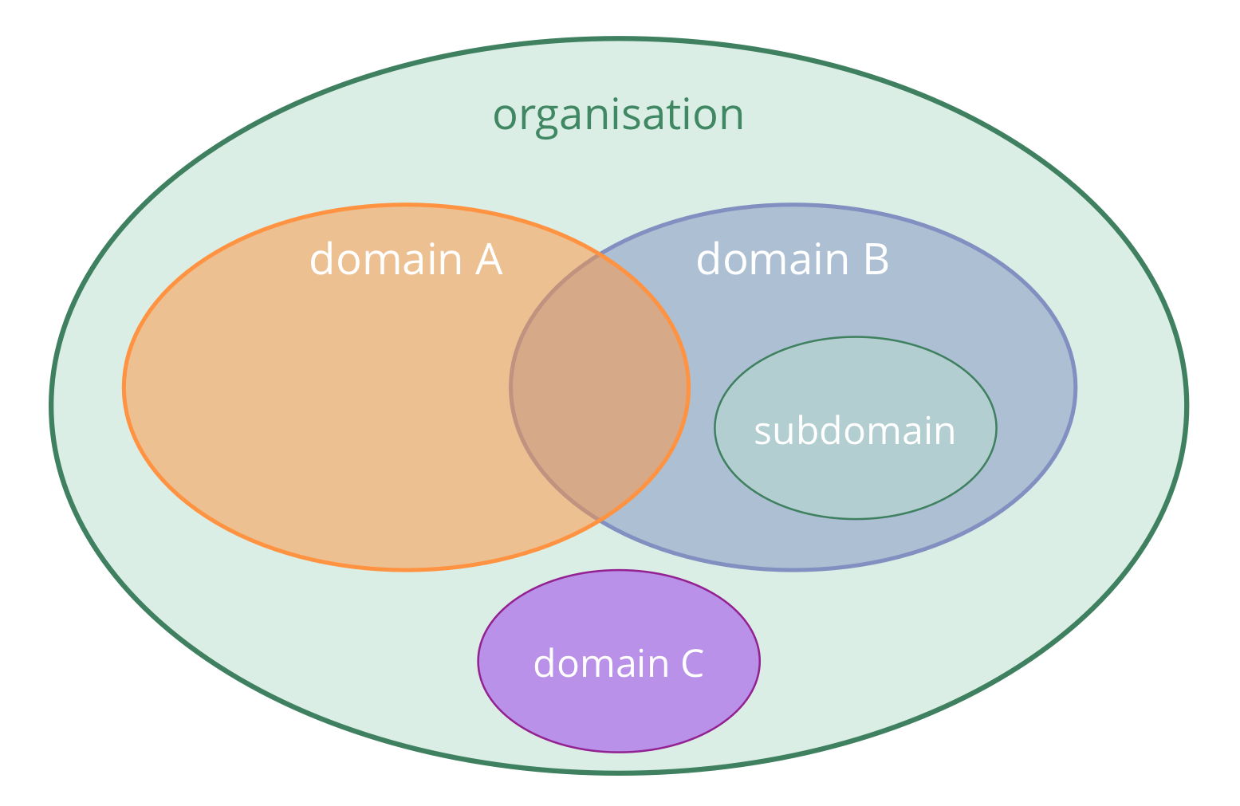
ORGANIZATION BY CIRCLES
Notes:
Open Systems
Intentionally communicate with and learn from others outside of your system.
Individuals, groups and entire organizations can acknowledge interdependence and intentionally invite people from outside their system to bring in knowledge, experience and influence to assist with decision making and support collective learning.
Acknowledging its interdependence, an organization can consciously invite outside information, influence or skills to assist with making decisions and to support collective learning.
External experts can offer an outside perspective and bring knowledge, understanding and skills
Representatives of affected parties can inform and influence decision making in ways that benefit overall objectives (see Those Affected Decide)

Slide 6
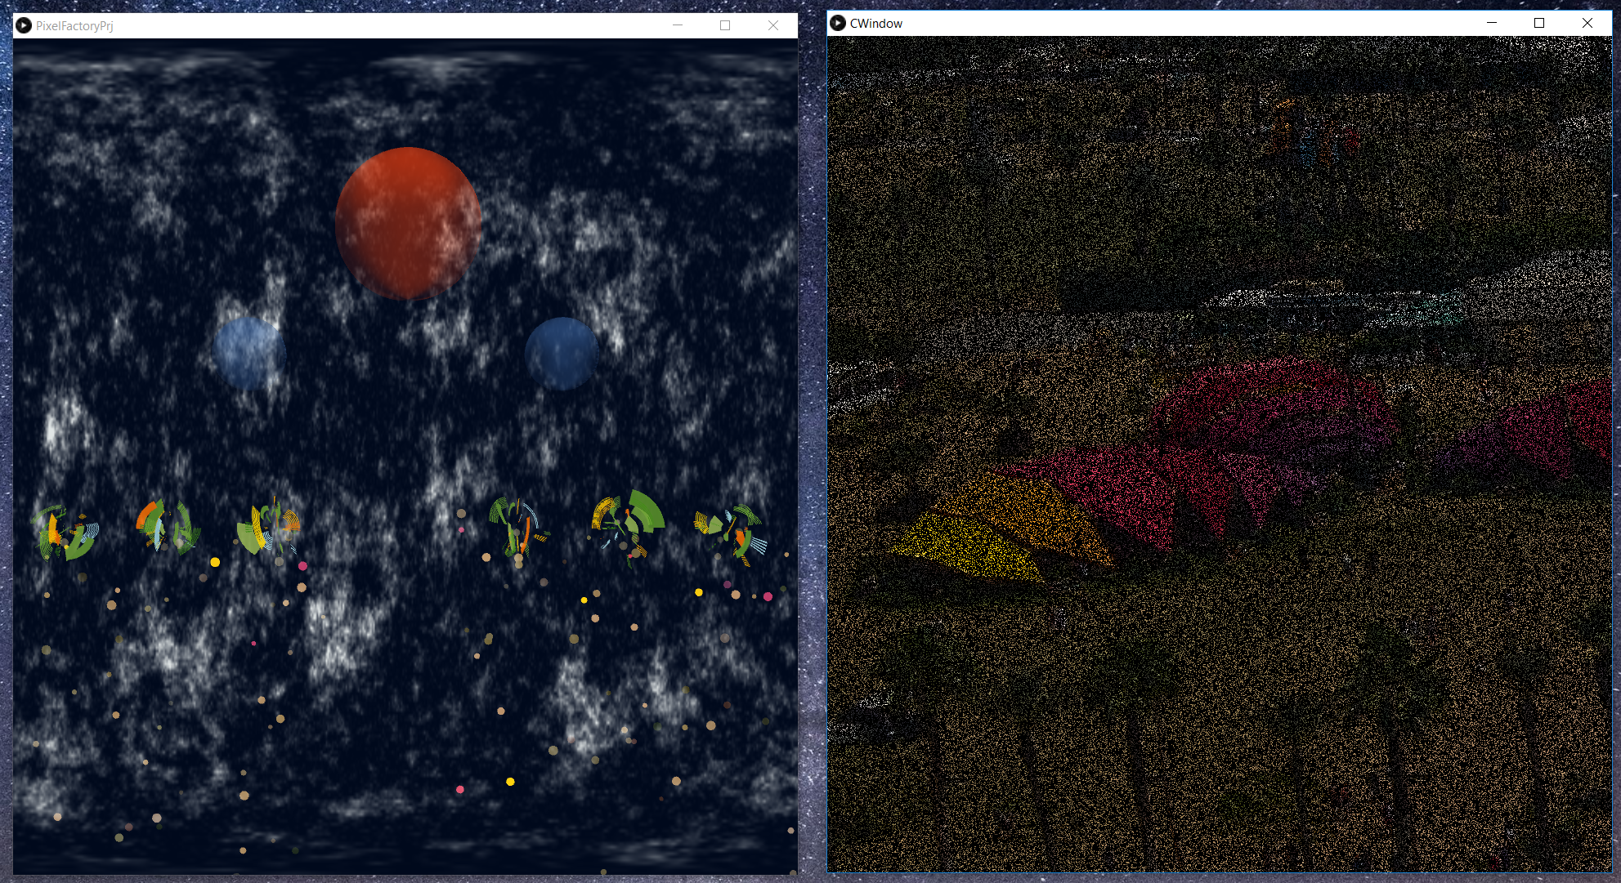
PIXEL FACTORY
Pixel Factory simulates a production environment under two different organizational structures, Hierarchical and Sociocracy based
Related organizational structures produce pixels to make a picture visible again which is initially blank
Picture represents a customer that uses pixels
There is a communications link between Pixel Factory organization and customer
For Future Tellers 2018 we submitted project in more basic form staying in the event theme
In the future we are planning to add more capabilities to simulate different communications capabilities and to drive some organizational behavior tests
We used Open Source components to build the system
Soundtrack files uses Creative Commons Licence

Slide 7
PIXEL FACTORY WITH HIERARCHY
Director
Manager
Employee
Employee
Manager
Employee
Employee
Employee
Employee
Red Sphere knows/decides which color will be produced
Employees ask to Red Sphere what they’ll produce
Only Red Sphere talks to Customer

Slide 8
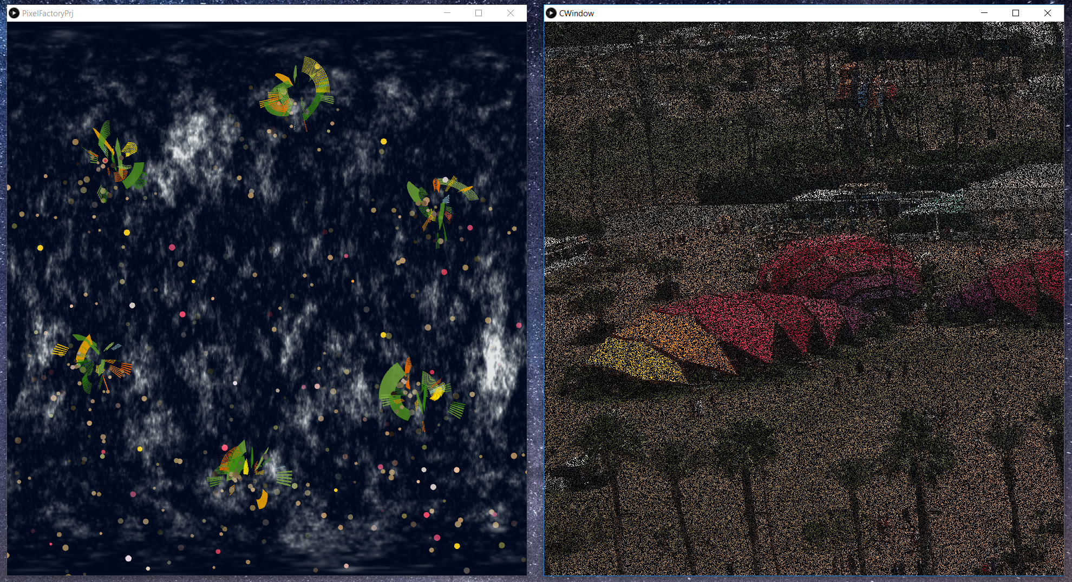
PIXEL FACTORY WITH HIERARCHY
Director
Manager
Employee
Employee
Manager
Employee
Employee
Employee
Employee
Red Sphere knows/decides which color will be produced
Employees ask to Red Sphere what they’ll produce
Only Red Sphere talks to Customer

